Slide 1
Siemens TIA Portal
Programs and Data Blocks
© 2014 John Sefcovic.

Slide 2




Block Structures
The PLC programs and information are structured into organization, functions, and data blocks.

Slide 3
Organization Block
Organization Blocks are the top level of the programming structure.
One Organization Block is continuously scanned,
Other Organization Blocks are scanned based on a predetermined Periodic time or on an Event.
Additionally, Organization Blocks can be continuously scanned, order of scan is based on the Organization Block’s number

Slide 4
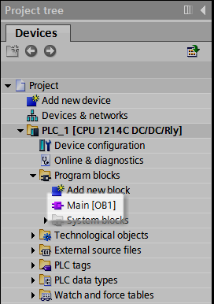
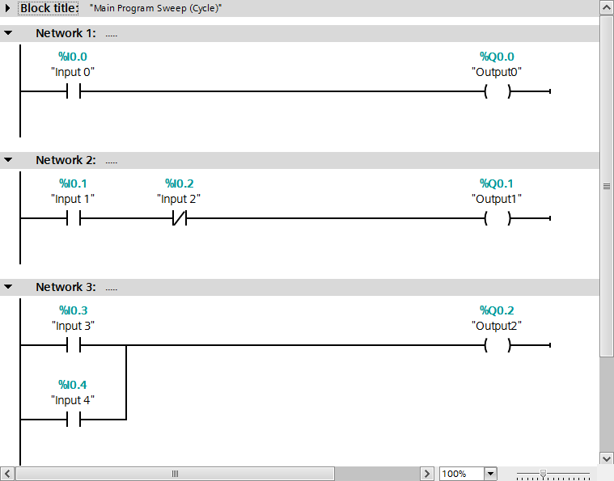
Organization Block
An Organization Block holds the Main program and is continuously scanned to execute the instructions in the program to control the machines or processes.
Program Logic in Main [QB1]

Slide 5

Subroutines
A project can be structured where one Block of program instructions calls another Block of program instructions, a sub-program or subroutine, to be executed for the control of the equipment by the PLC.
In this example, the Organization Block Main calls another Block of program instructions.
Main
Multiple Blocks of program instructions can be called by the Organization Block Main.
The Blocks can call additional Blocks of program instructions

Slide 6

Functions and Function Block Instances
The called programming Blocks are:
Functions [FC] subroutine program blocks are without dedicated memory to share Tag data values with other blocks.
The Tag data in Functions [FC] are Local to that Function [FC].
Function Blocks [FB] subroutine program blocks and store tag data values in Data Blocks [DB] for sharing data with the calling block.
Data Blocks [DB] store their Tag values that are associated with the Function Blocks [FB]. The Tag data values can be used by other blocks in the program.
The Tag data values in Data Blocks [DB] are Global.

Slide 7
Functions and Function Block Instances
Functions [FC] and Function Blocks [FB] contain the program instructions that corresponds to specific tasks and may pass data values when called.
These passed data values are called Instances.
In Functions [FC] the Instances are stored with the Function and associated only with the Function and its calling block.
In Functions [FC], the set of input and output Instances is optional.
In Functions Blocks [FB] the Instances are stored in associated Data Blocks [DB] and can be shared with any other block.

Slide 8
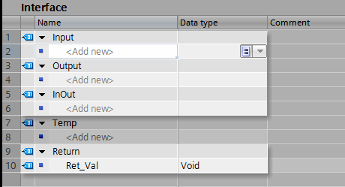
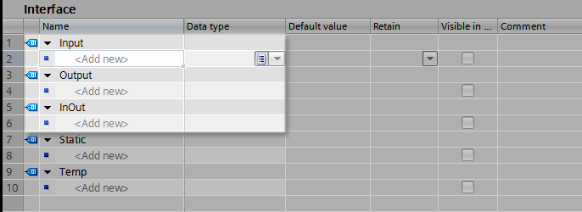
Functions and Function Block Instances
Instances are defined in the Interface.
When a Function [FC] uses data values, a Local Instance is defined in the Interface for the values. The Local Instance is used by that Function only.
A Function Block [FB] defines the Instance in the Interface and is associated with a Data Block. The values in the Data Block are Global Instances of the data and can be used by other blocks - Organization, Function Block, or Function.

Slide 9
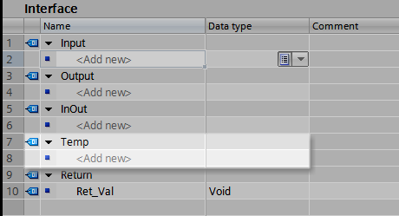
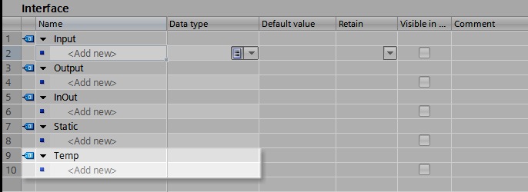
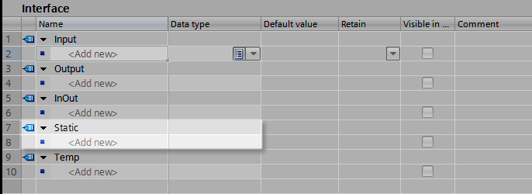
Functions and Function Block Instances
Temporary and Static parameters Tags are defined in the Interface.
Temp Tags are used to store temporary the intermediate values. Temporary data is retained for only one cycle in either Functions [FC] or Function Blocks [FB] and then returned to their initial values.
Static Tags are used for storage of intermediate values in the instance Data Block. Static data is retained until overwritten.

Slide 10
I/O and Memory Tags
Hardware Input and Outputs are defined as PLC Tags. These tags are associated with the I/O address and are Global to all programming blocks.
Additionally, there are Memory words of eight bit Bytes that are Global to all programming blocks.
The Memory can be assigned to Tags as Bit (Boolean), Single Integer (8 bits), Integer (16 bits) and Double Integer (32 bits) data.
Memory words are a legacy data structure.

Slide 11

Local and Global Block Data Tags
OB1
Tags Instances defined in OB1 are available to only OB1.
FC1
FB1
DB1
FB2
DB2

Slide 12
Local and Global Block Data Tags
OB1
FC1
Tags Instances defined in FC1 are available to only FC1.
FB1
DB1
FB2
DB2

Slide 13
Local and Global Block Data Tags
OB1
FC1
The Tags in DB1 are Instances from FB1, but are available to all programming blocks.
FB1
DB1
Instance of FB1
Tag names in DB1 are defined by FB1
FB2
DB2

Slide 14
Local and Global Block Data Tags
OB1
FC1
Tag names are defied in DB2 and available to all programming blocks.
FB1
DB1
Instance of FB1
FB2
DB2
Global
Tags defined in DB2

Slide 15
Local and Global Block Data Tags
OB1
Composite of Data Tag relationships.
FC1
PLC Tags
I/O Tags and
Memory Tags are Global.
FB1
DB1
Instance of FB1
Tags in DB1 are defined by FB1
FB2
DB2
Global
Tags defined in DB2

